Slide 1

Object Detection in
Adverse Weather Conditions
using Attention-Centric YOLO v12
BRACT’s Vishwakarma Institute of Information Technology Department of Information Technology
Machine Learning
Batch: TY B3
Name | Roll No. | PRN
Ali Sayyed | 332053 | 22211630
Abha Shah | 332054 | 22211516
Vinayak | 332068 | 22210621
Ayush Mahant | 332075 | 22320132
Guided By Prof. Riddhi Mirajkar
ML SCE: Object Detection in Adverse Weather Conditions, Department of IT, VIIT, Pune-48

Slide 2

CONTENTS
Abstract
Introduction
Literature Survey
System Design
Dataset Selection
Methodology & Implementation
Results and Discussion
Demo Video
Future Scope
Conclusion
ML SCE: Object Detection in Adverse Weather Conditions, Department of IT, VIIT, Pune-48

Slide 3
Introduction
With the drastic change in the weather condition the climate of country is changing which effects the driver results increase in loss of life.
This project focuses on enhancing object detection in autonomous vehicles under adverse weather conditions (Fog, Rain, Snow, and Storm) to improve safety and accuracy.
It evaluates state-of-the-art YOLO models (YOLOv10, YOLOv11m, and YOLOv12) using the DAWN dataset, with results showing that YOLOv12 performs best in accuracy and efficiency.
Autonomous Vehicels
Object Detection in adverse weather condition
ML SCE: Object Detection in Adverse Weather Conditions, Department of IT, VIIT, Pune-48

Slide 4
Dataset Selection and Training
1. Dataset Selection
Relevance: Adverse weather Images
Diversity: Different environments, conditions
Balanced Classes: Equal foggy, rainy, snowy, strom frames
Public Datasets: DAWN
2. Data Preprocessing
Frame Extraction: JPEG/PNG images with diverse weather conditions (Fog, Rain, Snow, Storm).
Labeling: Annotate images with bounding boxes and object classes
Resizing: Fixed resolution (e.g., 224x224)
Normalization: Scale pixel values (0-1); X′= X/255​
Augmentation: Rotate, flip, brightness
3. Model Training
Train/Test Split: 80% train, 20% test
Transfer Learning: Pre-trained YOLO12
Batch Size: 32/64
Learning Rate: Small (e.g., 0.001)
Loss Function: Binary/Categorical cross-entropy
4. Evaluation
Metrics: Accuracy, precision, recall, F1-score
Overfitting: Early stopping, dropout
Cross-Validation: Model generalization
ML SCE: Object Detection in Adverse Weather Conditions, Department of IT, VIIT, Pune-48

Slide 5
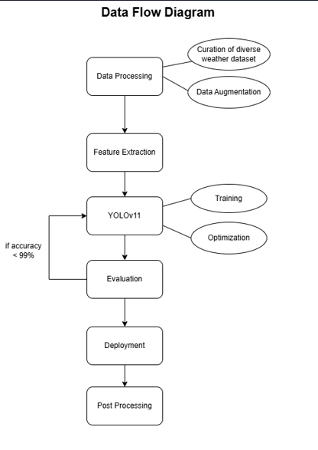
Methodology
Why YOLO12? YOLOv12 has shown superior detection accuracy (~86%) compared to YOLOv10 and YOLOv11m, making it more reliable for object detection in fog, rain, snow, and storms.
Training: The YOLO model is trained on thousands of image frames, with image analyzed to detect object with high accuracy.
Output: For each frame, the model computes the classes If it fits with in the class of training it detect it as an object.
ML SCE: Object Detection in Adverse Weather Conditions, Department of IT, VIIT, Pune-48

Slide 6
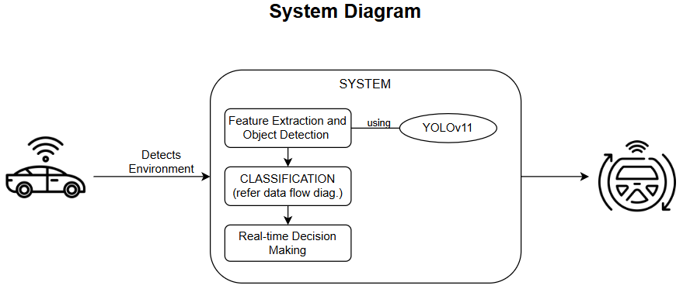
System Design
ML SCE: Object Detection in Adverse Weather Conditions, Department of IT, VIIT, Pune-48

Slide 7
Literature Survey
Sr. | TITLE (YEAR) | GOAL | DATA | METHODOLOGY | GAPS and Issues
2.
3.
4. | Deep Learning-Based Object Detection and Scene Perception under Bad Weather Conditions. (2022) | Develop an intelligent vehicle detection solution to address road traffic concerns, particularly under bad weather conditions, using deep learning. | Roboflow datasets Pretrained COCO weights. | Employed YOLO v5 for object detection, known for its speed and accuracy | Focused only on with and without rain.
5. | Fusion-based modeling of an intelligent algorithm using a Deep Learning Approach on radar and camera data (2025) | Deep learning-based object detection system that enhances the reliability and accuracy of detection by fusing radar and camera data. |  | Radar and Camera Data Calibration Object Detection: YOLO v8 is applied. Object Classification: BiLSTM model. Hyperparameter Optimization: The Adam optimizer. Achieved an accuracy of 90.59%. | Does not contain adverse weather conditions.

Slide 8
Literature Survey
6. | Impact of Rain on Image Quality From Sensors on Connected and Autonomous Vehicles Year: 2025 | Investigate the impact of rain on the quality of images taken by sensors on connected and autonomous vehicles. |  | Experimental Setup: Varying rain intensity in a controlled manner to capture images under different conditions. Image Quality Analysis: Metrics such as signal-to-noise ratio (SNR), Weber contrast, and color error. Results: 45% reduction in SNR at 40 meters and 38 mm/h, a 70% maximum decrease in Weber contrast at 30 meters and 38 mm/h, and a 42% increase in color error due to rain. | The study focused on analyzing rain patterns which can be used for parameter based model integration but not generalization of the model.
7. | Fairness in Autonomous Driving: Towards Understanding Confounding Factors in Object Detection under Challenging Weather Year: 2024 | Comprehensive empirical analysis of fairness in detecting pedestrians using a state-of-the-art transformer-based object detector, particularly under challenging weather conditions. | FACET dataset and | Data Calibration, Attribute Analysis, BiLSTM Carla high-fidelity vehicle simulator explores effect of attributes gender, skin tone, and body size on performance. Hyperparameter Optimization: Adam optimizer for selecting the optimum hyperparameters of BiLSTM network | Focused on pedestrian detection using complex and computationally costly novel approach. Limited to pedestrian detection.
8. | Analyzing Performance of YOLOx for Detecting Vehicles in Bad Weather Conditions Year: 2024 | Investigate the use of the YOLOx model for detecting vehicles in bad weather conditions, including rain, fog, snow, and sandstorms, to improve the reliability and accuracy of autonomous vehicle systems. | DAWN dataset | Data Preprocessing: Images from the DAWN dataset were resized and rescaled to maintain the height-to-width ratio. Model Training: The YOLOx(YOLOx-s, YOLOx-m, and YOLOx-l) were used for performance analysis. | YOLOx struggles with feature degradation, occlusions, and low visibility in extreme conditions like dense fog or heavy rain
9. | Title: Object detection in adverse weather condition for autonomous vehicles Year: 2024 | The paper aims to provide an efficient and effective approach for autonomous vehicles to accurately detect objects during adverse weather conditions. | The researchers used the DAWN dataset, which contains images of real traffic conditions under various weather conditions, including rain, fog, snow, and sandstorms. | Data Preprocessing: Images from the DAWN dataset were resized and rescaled to maintain the height-to-width ratio. Model Training: The YOLOv7 model was trained using the preprocessed images. ESRGAN was used to enhance the images before detection. Performance Evaluation: The model's performance was evaluated in terms of accuracy in detecting objects during adverse weather conditions. | The paper addresses the challenge of improving object detection accuracy in adverse weather conditions, which can significantly impact the performance of autonomous vehicles.
10. | Title: Object detection in adverse weather condition for autonomous vehicles Year: 2024 | The paper aims to provide an efficient and effective approach for autonomous vehicles to accurately detect objects during adverse weather conditions. | The researchers used the DAWN dataset, which contains images of real traffic conditions under various weather conditions, including rain, fog, snow, and sandstorms. | Data Preprocessing: Images from the DAWN dataset were resized and rescaled to maintain the height-to-width ratio. Model Training: The YOLOv7 model was trained using the preprocessed images. ESRGAN was used to enhance the images before detection. Performance Evaluation: The model's performance was evaluated in terms of accuracy in detecting objects during adverse weather conditions. | The paper addresses the challenge of improving object detection accuracy in adverse weather conditions, which can significantly impact the performance of autonomous vehicles.

Slide 9
Literature Survey
Sr. | TITLE (YEAR) | GOAL | DATA | METHODOLOGY | GAPS and Issues
11. | Domain Adaptive Object Detection for Autonomous Driving Under Foggy Weather Year: 2023 | Domain adaptive object detection framework for autonomous driving under foggy weather conditions. | RTTS | Image-Level and Object-Level Adaptation: Adversarial Gradient Reversal Layer:. Auxiliary Domain Generation Experimental Results | Limited to foggy weather.
12.
13. | Deep Learning-Based Image 3-D Object Detection for Autonomous Driving: Review Year: 2025 | Review the current state of deep learning-based 3-D object detection techniques for autonomous driving and highlight the challenges and future directions in this field. | KITTI WAYMO | The paper conducts a comprehensive review of existing deep learning-based 3-D object detection models and their performance. Comparison of Models: On speed, accuracy, Map. | Lacks multifold weather conditions, includes on two such environments.
14.
15.

Slide 10
Literature Survey: Findings
We reviewed 15 papers for this project. This is a summary of our findings from the literature survey.
Machine learning models, particularly CNN and YOLO, are commonly used for real-time video analysis and anomaly detection in smart surveillance systems.
Current frameworks show effectiveness in detecting accidents and traffic violations but face scalability issues, especially in large and dense urban environments.
Many systems prioritize improving video data quality but fail to address real-time alert mechanisms for immediate emergency intervention.
Environmental factors such as weather conditions and low-quality video feeds are often overlooked, limiting the effectiveness of these systems in real-world scenarios.
ML SCE: Object Detection in Adverse Weather Conditions, Department of IT, VIIT, Pune-48

Slide 11
YOLO Algorithm
Layer 1
Layer 2
Layer 3
Layer 1: Input Image Processing(Low-Level Feature Extraction)
Neck (Feature Fusion & Attention Mechanisms)
Head (Prediction & Bounding Box Regression)
The input image is resized to a fixed dimension (e.g., 640×640).Pixel values are normalized (0-1) for better training stability.If applicable, preprocessing techniques like blurring (for foggy environments) and contrast adjustment (for low-visibility) are applied.
The neck module includes PAN (Path Aggregation Network) and BiFPN (Bidirectional Feature Pyramid Network), helping in multi-scale feature fusion. Attention mechanisms (CBAM or SE blocks) allow the model to focus on important object regions, reducing the impact of noise from rain or fog.
The detection head predicts bounding boxes, class labels, and confidence.Anchor-free mechanism (introduced in YOLOv12) improves detection accuracy for small objects, critical in adverse weather where objects may be partially visible. The output consists of bounding boxes with confidence scores for each detected object.
ML SCE: Object Detection in Adverse Weather Conditions, Department of IT, VIIT, Pune-48

Slide 12
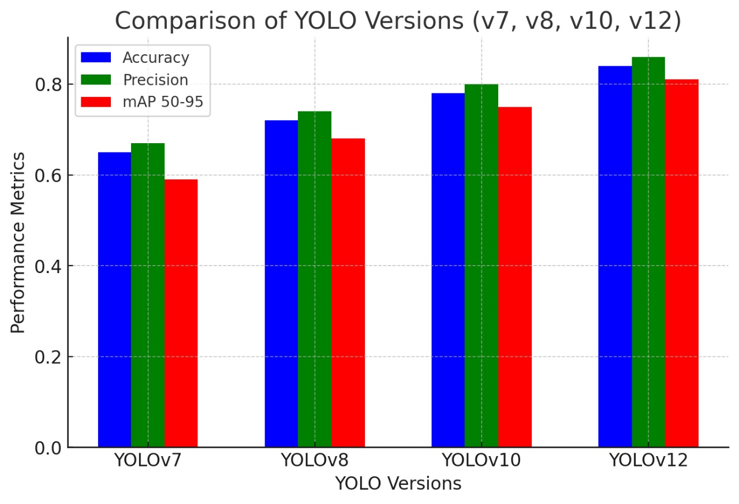

Slide 13
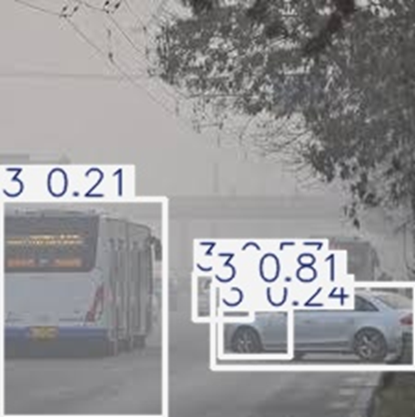
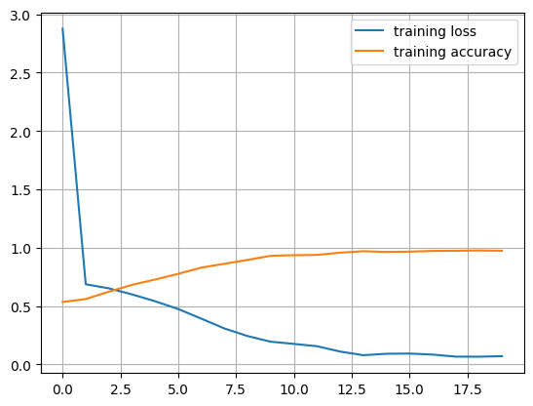
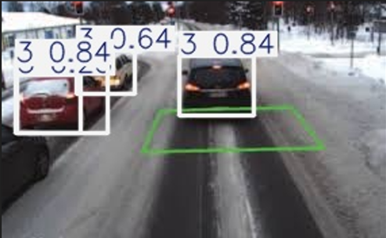
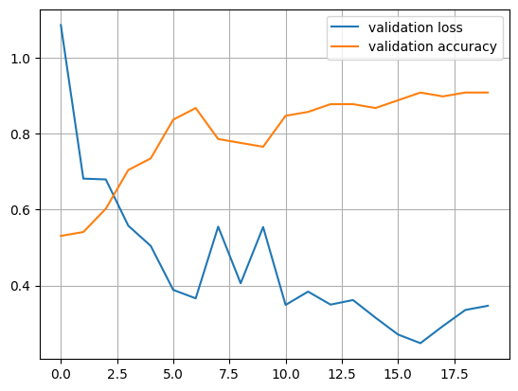
Training Results
This graph helps visualize how the model's learning process improves as training progresses. By the end of training, the loss has significantly decreased and the accuracy has neared 1.0, indicating near 100% accuracy.
This graph is used to monitor how well the model generalizes to unseen data during training. It is generated using a validation dataset. The slight upward curve of the validation loss towards the end indicates overfitting.
We used a test dataset to visualize the model’s accuracy and generated about 40 results as shown in the image above.
ML SCE: Object Detection in Adverse Weather Conditions, Department of IT, VIIT, Pune-48

Slide 14

Demonstration Video
ML SCE: Object Detection in Adverse Weather Conditions, Department of IT, VIIT, Pune-48

Slide 15
Future Scope
Real-Time Optimization
🔹 Quantization – Reduces model size by converting high-precision (32-bit floating-point) weights to lower-bit representations (e.g., 8-bit integers), improving speed and memory efficiency.
🔹 Pruning – Removes insignificant neurons or weights in the neural network, reducing computational complexity without significant loss of accuracy
.
🔹 Hardware-Specific Acceleration – Leverage TensorRT, OpenVINO, or ONNX Runtime for optimized inference on GPUs, TPUs, and edge devices.
Adaptive Object Detection
🔹 Weather-Aware Training – Train models on diverse datasets, including fog, rain, snow, and storms, using domain adaptation to minimize performance drops
.
🔹 Augmented Data Synthesis – Generate synthetic adverse weather conditions to ensure robustness against unseen scenarios.
🔹 Online Learning & Fine-Tuning – Implement self-supervised learning where the model fine-tunes itself using real-time sensor feedback and past experiences.
Real-World Testing
🔹 AirSim (Aerial & Ground Vehicles) – Developed by Microsoft, AirSim simulates autonomous cars and drones, allowing AI models to interact with dynamic objects, pedestrians, and varying terrains.
🔹 Hardware-in-the-Loop (HIL) Testing – Integrate real-world sensor data (from LiDAR, RADAR, and cameras) with simulated environments to fine-tune model accuracy.
🔹 Edge Deployment Validation – Test optimized models on low-power edge devices (NVIDIA Jetson, Raspberry Pi) to assess inference speed and power efficiency before real-world trials.
ML SCE: Object Detection in Adverse Weather Conditions, Department of IT, VIIT, Pune-48

Slide 16
CONCLUSION
Enhancing object detection in adverse weather is essential for autonomous vehicle safety. Our research confirms that YOLO v12 excels in accuracy and efficiency, making it the best choice for real-world deployment. By leveraging multi-modal sensor fusion, real-time optimization, adaptive learning, and rigorous simulation testing, we ensure robust performance across diverse conditions. These innovations drive the future of intelligent, self-learning perception systems, enabling autonomous vehicles to navigate safely through fog, rain, snow, and storms with unparalleled precision and reliability.
We would also like to thank respected faculty, Mrs. Riddhi Mirajkar Ma’am for her help and support in our entire project duration.
ML SCE: Object Detection in Adverse Weather Conditions, Department of IT, VIIT, Pune-48

Slide 17
References
https://www.geeksforgeeks.org/introduction-convolution-neural-network/
https://softengi.com/blog/video-analytics-software-development-for-smart-traffic/
https://www.policycircle.org/society/india-road-safety-with-ai/#:~:text=AI%20camera%20surveillance%20in%20Kerala,to%20the%20central%20government's%20server
https://ieeexplore.ieee.org/document/8537279
https://lampyridjournal.com/index.php/journal/article/download/123/122
https://www.researchgate.net/publication/356664320_Time_to_reach_health-care_facility_and_hospital_exit_outcome_among_road_traffic_accident_victims_attending_a_tertiary_care_hospital_Puducherry/citations
ML SCE: Object Detection in Adverse Weather Conditions, Department of IT, VIIT, Pune-48

Slide 18
Thank You!
ML SCE: Object Detection in Adverse Weather Conditions, Department of IT, VIIT, Pune-48

